Slide 1
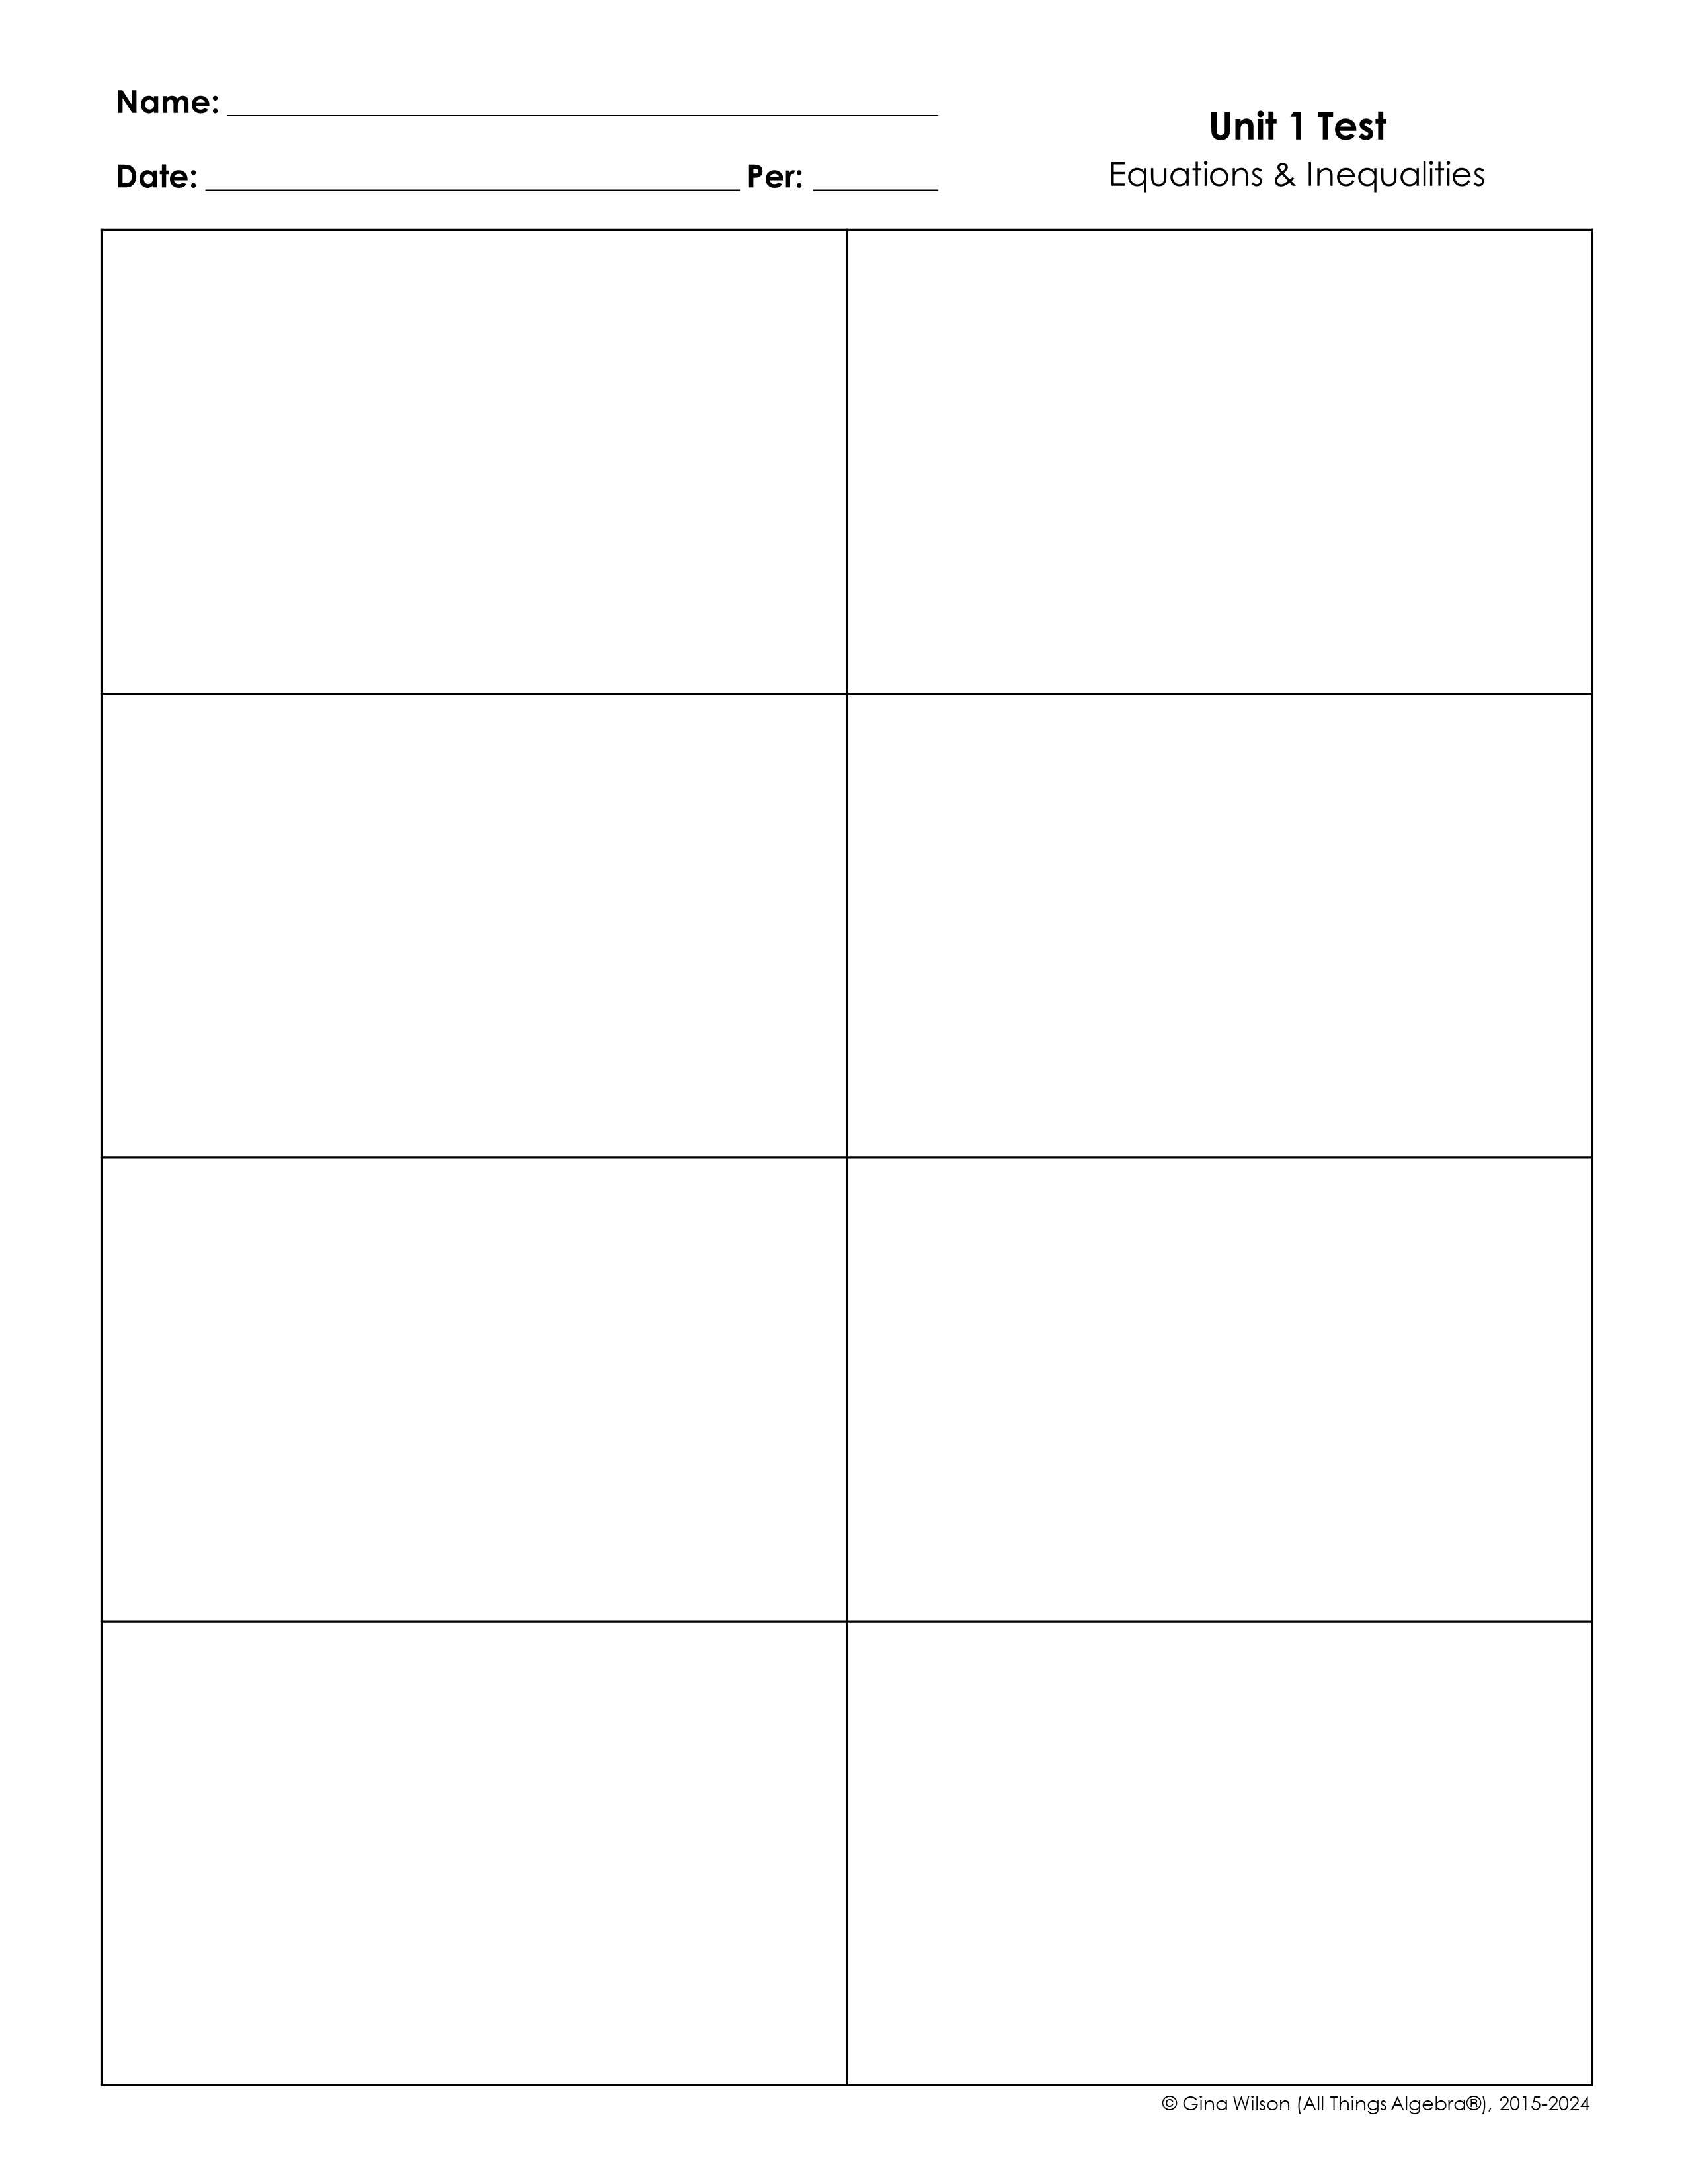
1. Which value is a perfect square?
2. If the expression below is written in simplest radical form, which must be true?
a
b
A. 198 B. 249 C. 361 D. 500
A. a + b = 17 B. a + b = 23 C. a + b = 29 D. a + b = 31
3. Which expression is correctly written in simplest form?
4. Which set of numbers does not contain the value below?
A. B. C. D.
A. R B. N C. Z D. Q
5. Which of the following lists of values contain rational numbers only?
6. Which is the smallest subset of the real numbers that contains the value below?
A.
B.
C.
D.
A. R B. N C. W D. Z
7. Simplify the expression below.
8. Simplify the expression below.

Slide 2

9. Evaluate the expression below if m = -4, n = 3, and p = 12.
10. Evaluate the expression below if x = , y = , and z = .
11. Solve the equation below.
12. Solve the equation below.
a =
x =
13. Which equation has a solution of all real numbers?
14. Solve the equation below.
A. 5k – (6k – 18) = 9 – k + 17 B. 14 – 5(y + 10) = 4 – 8(y + 5) C. 6(-2w – 3) = -4(3w + 7) + 10 D. 7m – 2(2m + 3) = 8 – (3m – 10)
p =

Slide 3
15. Solve the equation below for m.
16. If 2x – 1 = 13, evaluate the expression below.
A. m = 40n B. m = 18n C. m = 8n D. m = 20n
A. 12 B. 21 C. -60 D. -77
17. This past Sunday, the Giants scored 9 points less than twice the Cowboys. The Packers scored 14 more points than the Giants. If the teams scored 81 total points, find the number of points scored by the Packers.
18. The sum of three consecutive numbers is 41 less than five times the largest number. Find the largest number.
19. Solve the equation below.
20. Solve the equation below.
x =
c =

Slide 4
















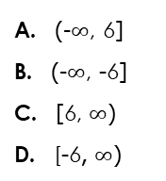
21. Solve the equation below.
22. Which graph represents the solution to the inequality below?
A. B. C. D.
w =
23. Which represents the solution to the inequality below in interval notation?
24. Which graph represents the solution to the compound inequality below?
A. B. C. D.
A. (-$∞$, 6] B. (-$∞$, -6] C. [6, $∞$) D. [-6, $∞$)
25. Which graph represents the solution to the compound inequality below?
26. Which graph represents the solution to the compound inequality below?
A. B. C. D.
A. B. C. D.

Slide 5





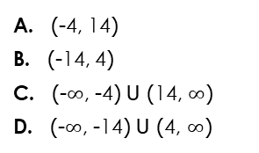
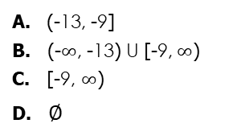
27. Which represents the solution to the compound inequality below in interval notation?
28. Which value of x is not in the solution to the compound inequality below?
A. (-13, -9] B. (-$∞$, -13) U [-9, $∞$) C. [-9, $∞$) D. $∅$
A. -3 B. 0 C. 4 D. 7
29. Which graph represents the solution to the inequality below?
30. Which represents the solution to the inequality below in interval notation?
A. B. C. D.
A. (-4, 14) B. (-14, 4) C. (-$∞$, -4) U (14, $∞$) D. (-$∞$, -14) U (4, $∞$)
BONUS: A change jar contains nickels, dimes, and quarters, totaling an amount of $1.90. The number of nickels is one more than twice the number of dimes. The number of quarters is one half the total number of nickels and dimes. Find the number of each coin in the change jar.

